Slide 1
AMAZON SALES - ANALYSIS
2010-2017

Slide 2
INTRODUCTION
Today, Amazon offers an extensive range of products, including clothing, electronics, beauty supplies, gourmet food, jewelry, movies, toys, and more. Its vast inventory and customer-centric approach have made it the world’s largest online retailer.

Slide 3
PROBLEM STATEMENT
Sales management has gained importance to meet increasing competition and the need for improved methods of distribution to reduce cost and to increase profits. Sales management today is the most important function in a commercial and business enterprise.

Slide 4
STEPS INVOLVED IN DATA ANALYSIS
Problem Statement
Data Collection
Data Cleaning
Analysing the Data
Data Visualisation
Data Presentation

Slide 5
Dataset
Attributes
Region
Country
Item
Type
Sales Channel
Order Priority
Order Date
Order ID
Ship Date
Units Sold
Unit Price
Unit Cost
Total Revenue
Total Cost
Total Profit

Slide 6
Main KPI’s
Total Profit per Year
Average Revenue per month
Total Revenue by Region
Total profit by country
Sales in Online vs Sales in Offline
Sum of Unit Sold
Sum of Total Cost

Slide 7
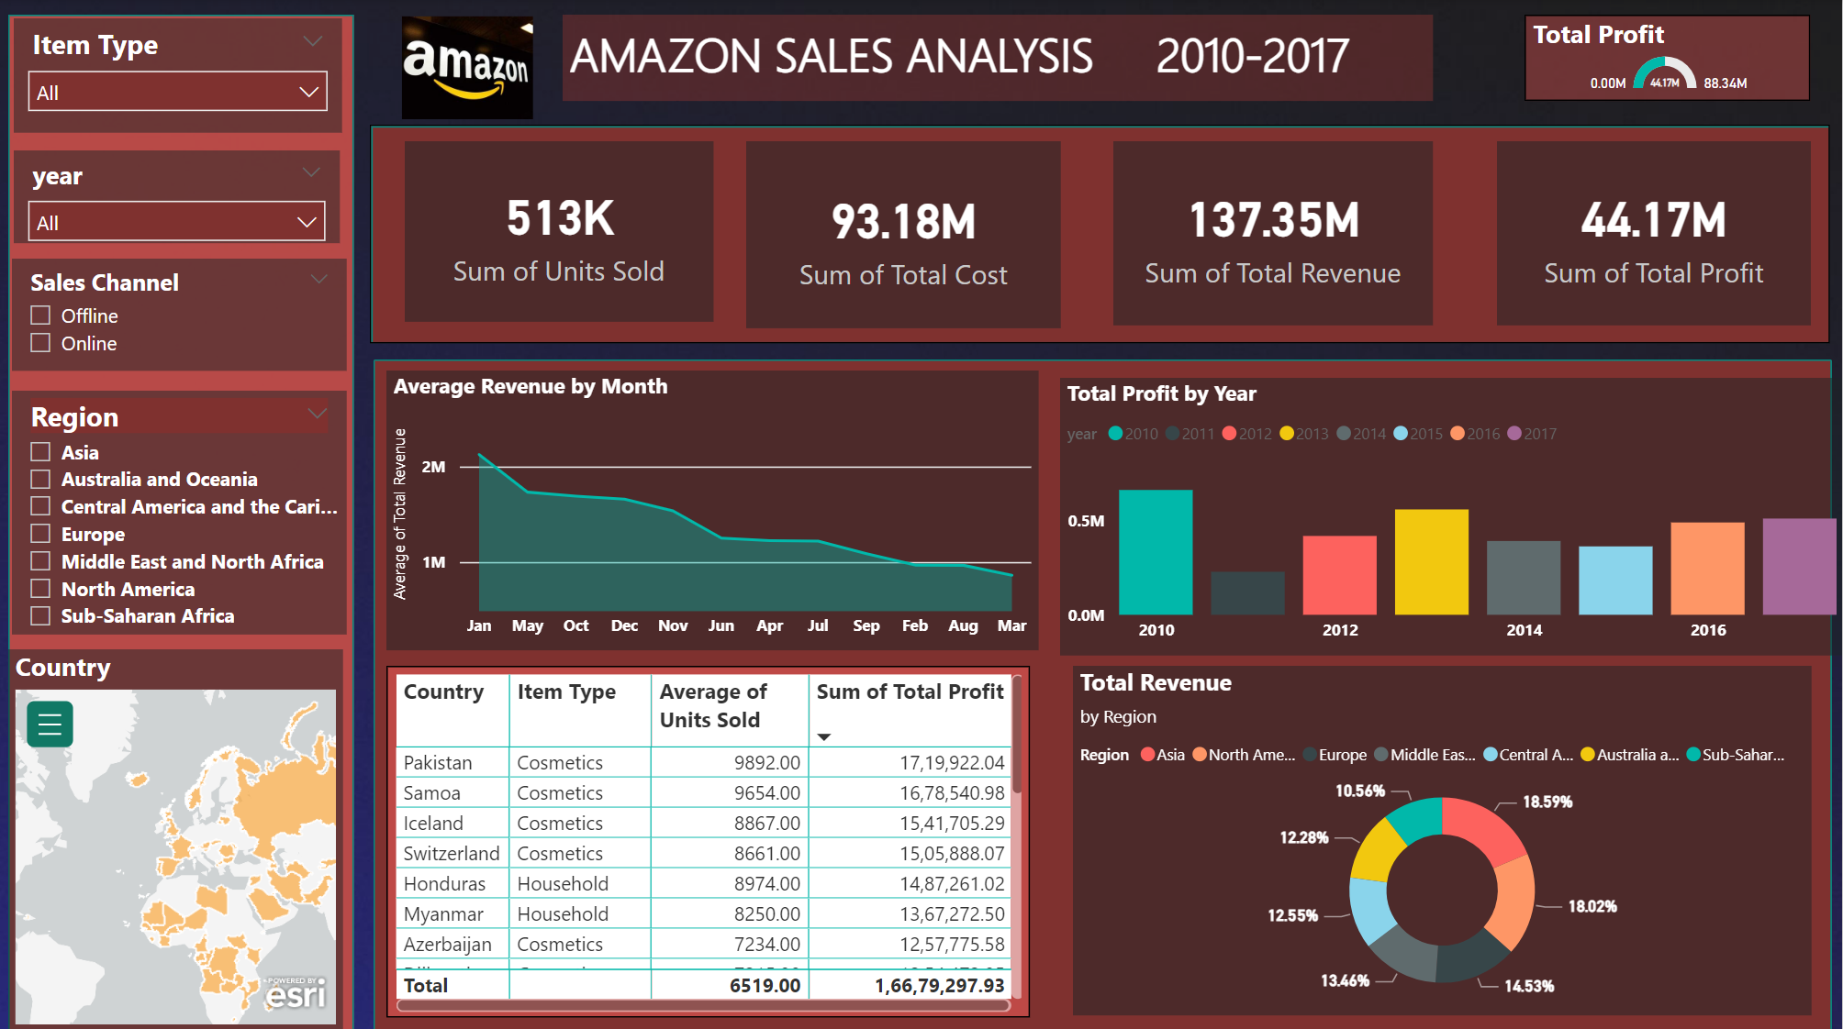
SALES ANALYSIS DASHBOARD

Slide 8
OBSERVATIONS
Highest sales were made in the year 2010.
Maximum profit was made in the year 2010.
More Revenue was generated with the Item Type Cosmetics.
Asia achieved highest profit in the Amazon sales.
Australia and Oceania made the lowest profit.
Lowest profit was made in the year 2011 with lowest sales.
Lowest revenue was generated by Fruits.
Highest Revenue Generated in the month of January.

Slide 9
CONCLUSION
To improve Amazon sales:
Optimize Amazon Product Listing .
Get Reviews .
Arm Yourself Against Competitors .
Leverage Automation for Pricing .
Find the Right Keywords .
Focus on Inventory .
Run On-Amazon Promotions .
Use a Variety of Ad Types .

Slide 10
THANK YOU

